Slide 1

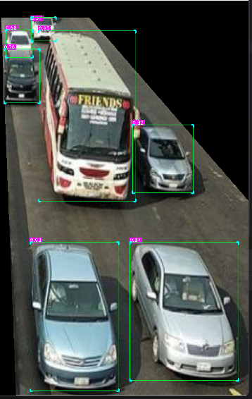
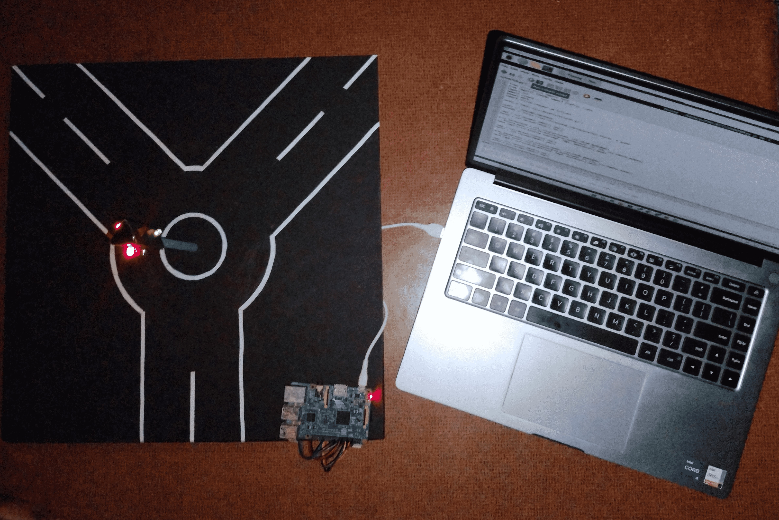
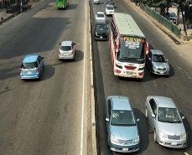
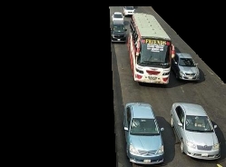
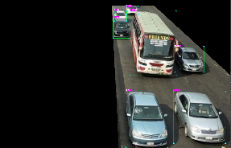
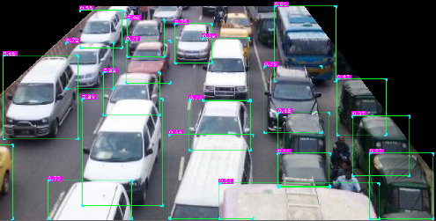
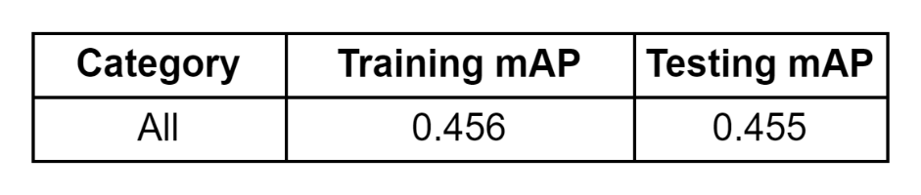
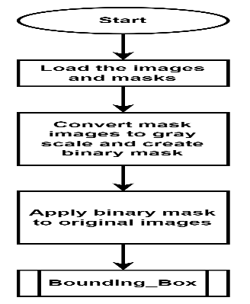
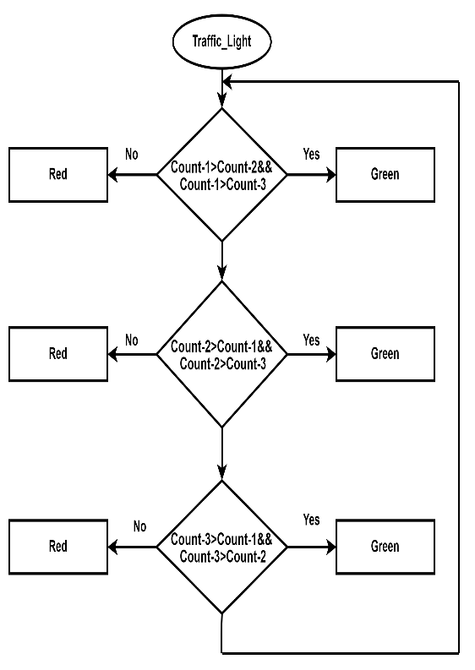
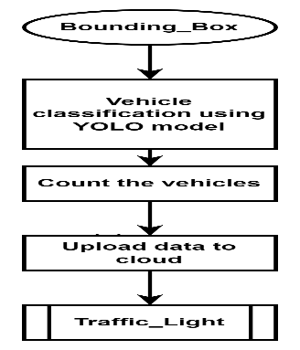
SMART TRAFFIC LIGHT MANAGEMENT
By:
Sunil Danappa Biradar [1SI20EC097]
Thrinesh S [1SI20EC102]
Varun M [1SI20EC107]
Shilpashree SP [1SI20EC112]
Under the guidance of,
Dr. Y Harshalatha
Assistant Professor
INTRODUCTION
Input Image
Apply Binary Mask
Vehicle Classification using YOLO model
EXPERIMENTAL RESULTS
The present traffic control systems that are used are either manually controlled or automatic controlling system. The former requires manpower and is less efficient. The latter uses static time allocation irrespective of traffic density. Even though the road is free the vehicles are made to wait to match the allocated time. The intended project makes traffic light control more efficient. This system will intelligently decide when to alter signals based on the total traffic on each road.
SYSTEM HARDWARE
OBJECTIVES
Raspberry Pi
To measure the vehicle count using YOLO model and to control the traffic signals accordingly.
To upload traffic density information to the cloud for future analysis.
Cloud
Image Pre-processing
SYSTEM OVERVIEW
Input Image
By analyzing vehicle count values, the system can identify the lane with high traffic congestion and controls the traffic signals.
Input Image
Image Pre-processing
Counting the vehicles in the lane
FLOWCHART
CONCLUSION
Sending the data to cloud
Setup the timings for the Traffic Signals
Priority based on vehicle count
The project titled “Smart Traffic Light Management System” is designed using Image processing, YOLOv8 model and Raspberry-Pi. The YOLOv8 model is used for detection and counting of vehicles. The system controls the traffic signal based on vehicle count.
METHODOLOGY
Input the images and apply a binary mask to the image. Then, using OpenCV to process the images for filtering, or enhancing the image quality. Apply the YOLOv8 model for accurate and efficient vehicle detection on the captured images. Extract relevant data from the detected vehicles, such as vehicle counts. Visualize the data by drawing bounding boxes around the detected vehicles on the original image. Additionally, perform analysis to identify patterns in traffic flow and peak hours. This analysis will enables to optimize traffic management during high traffic periods.
REFERENCES
S. Chen and W. Lin, “Embedded System Real-Time Vehicle Detection based on Im-proved YOLO Network,” 2019 IEEE 3rd Advanced Information Management, Com-municates, Electronic and Automation Control Conference (IMCEC), Chongqing,China, 2019.
D. Ijeri, P. Maidargi and R. Sunagar, “Traffic Control System Using Image Proc-cesing,” 2020 IEEE Bangalore Humanitarian Technology Conference (B-HTC), Vi-jiyapur, India, 2020.

